Slide 1

Apache Spark
Swiss Army knife of big data analytics

Slide 2
Presented by:
Yomna Tarek Gamal
Dana aboelyazed elshrbiny
Supervised by :
Dr/ Ahmed elsayed

Slide 3


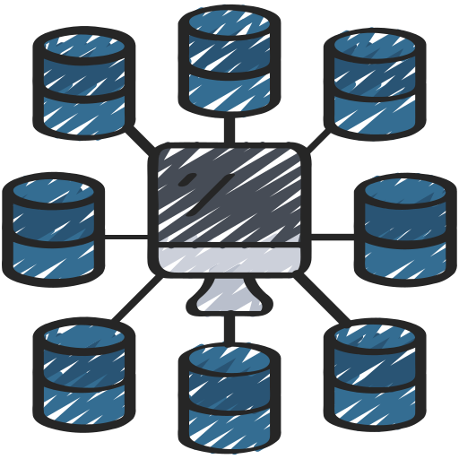
Table of content
01
What’s spark and it’s Evolution
02
Why Spark
03
Ecosystem Components
04
Resilient Distributed Datasets (RDD)

Slide 4
01
What’s spark and it’s Evolution

Slide 5
Apache spark
Is a data processing engine. It is most commonly used for large data sets. Apache Spark often called just ‘Spark’, is an open-source data processing engine created for Big data requirements. It is designed to deliver scalability, speed, and programmability for handling big data for machine learning, artificial intelligence, streaming data, and graph data applications.

Slide 6
Evolution of Apache Spark
Spark was first developed at UC Berkley in 2009. Now, it is handled & owned by Apache Software Foundation. Apache Spark has the largest open source community in big data. It has more than 1000 contributors. Now, its also being included as one of the core components in several commercial extensive data offerings.

Slide 7
02
Features of Apache spark

Slide 8
Features of Apache Spark
spark decreases the number of reads and write operations on the disk. Spark stores the intermediate steps in memory
Speed
Spark supports Machine Learning, Artificial Intelligence, SQL queries, and Graph Algorithms.
Advanced Analytics
Spark provides built-in APIs in many languages, including Python, Java, and Scala. So, you can write your application in any language
Supports Multiple Languages
Features of Apache Spark
Reusability
Spark code can be used for batch-processing, joining streaming data against historical data as well as running ad-hoc queries on streaming state.
Integrated with hadoop
It offers support to multiple file formats like parquet, json, csv, ORC, Avro etc. Hadoop can be easily leveraged with Spark as an input data source or destination.
Cost Effiecient
Spark does not have any locking with any vendor, which makes it very easy for organizations to pick and choose Spark features as per their use case.

Slide 9
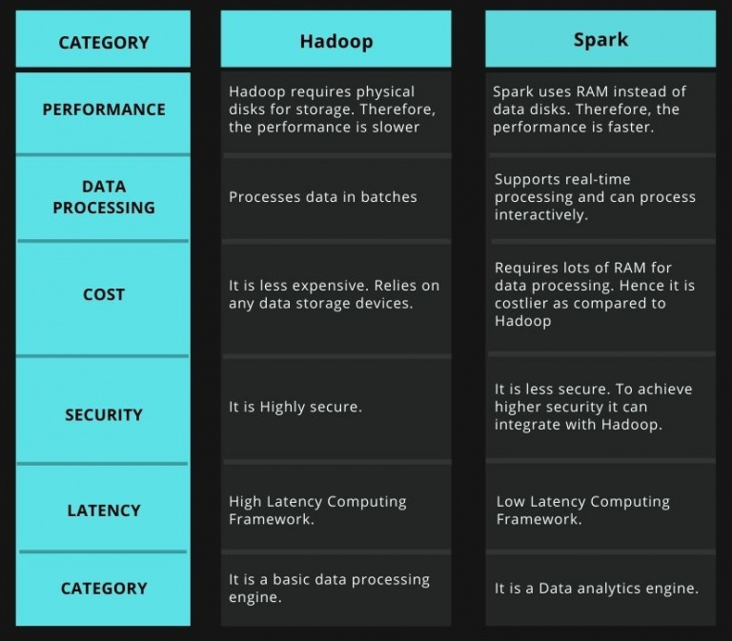
Hadoop vs spark

Slide 10
03
Ecosystem Components

Slide 11
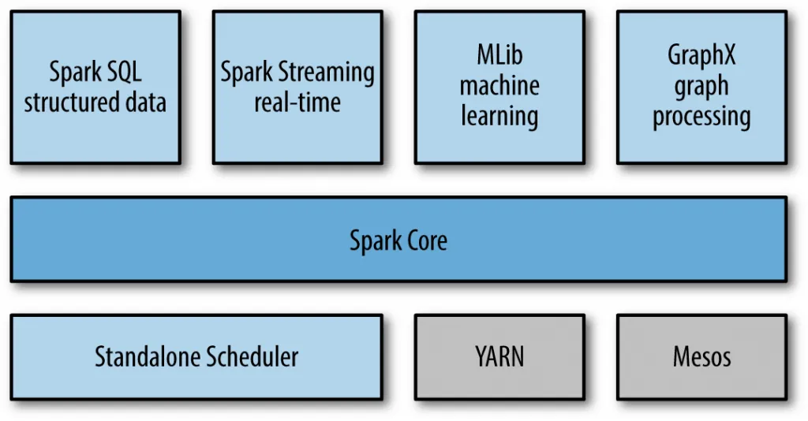
Spark main components

Slide 12
SQL & Data Frames: is a Spark component that supports data querying using either SQL or Data Frame API. Both help to access a variety of data sources, including Hive, Avro, Parquet, ORC, JSON, and JDBC in the usual way. There is even a possibility to join data across the mentioned sources.
Spark Streaming: supports real-time streaming processing. Such data can be log files of the working web server (for example, processed by Apache Flume or placed on HDFS / S3), information from social networks (for example, Twitter), as well as various message queues such as Kafka.
Mllib: is a machine learning library that provides various algorithms designed for horizontal scaling on a cluster for classification, regression, clustering, co-filtering, etc.
GraphX: is a library for manipulating graphs and performing parallel operations with them. The library provides a universal tool for ETL, research analysis and graph-based iterative computing.
Spark Core: is a basic engine for a large-scale parallel and distributed data processing.
The core is responsible for:
memory management and recovery after failures.
planning, distribution, and tracking of tasks in a cluster.
interaction with storage systems.

Slide 13
04
Resilient Distributed Datasets (RDD)

Slide 14
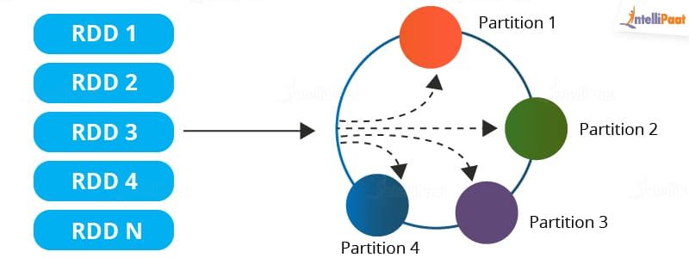
Resilient Distributed Datasets (RDDs): RDDs are the main logical data units in Spark. They are a distributed collection of objects, which are stored in memory or on disks of different machines of a cluster. A single RDD can be divided into multiple logical partitions so that these partitions can be stored and processed on different machines of a cluster.
RDDs are immutable (read-only) in nature. You cannot change an original RDD, but you can create new RDDs by performing coarse-grain operations, like transformations, on an existing RDD.

Slide 15
Features of an RDD in Spark
Resilience: RDDs track data lineage information to recover lost data, automatically on failure. It is also called fault tolerance.
Distributed: Data present in an RDD resides on multiple nodes. It is distributed across different nodes of a cluster.
Lazy evaluation: Data does not get loaded in an RDD even if you define it. Transformations are actually computed when you call action, such as count or collect, or save the output to a file system.

Slide 16
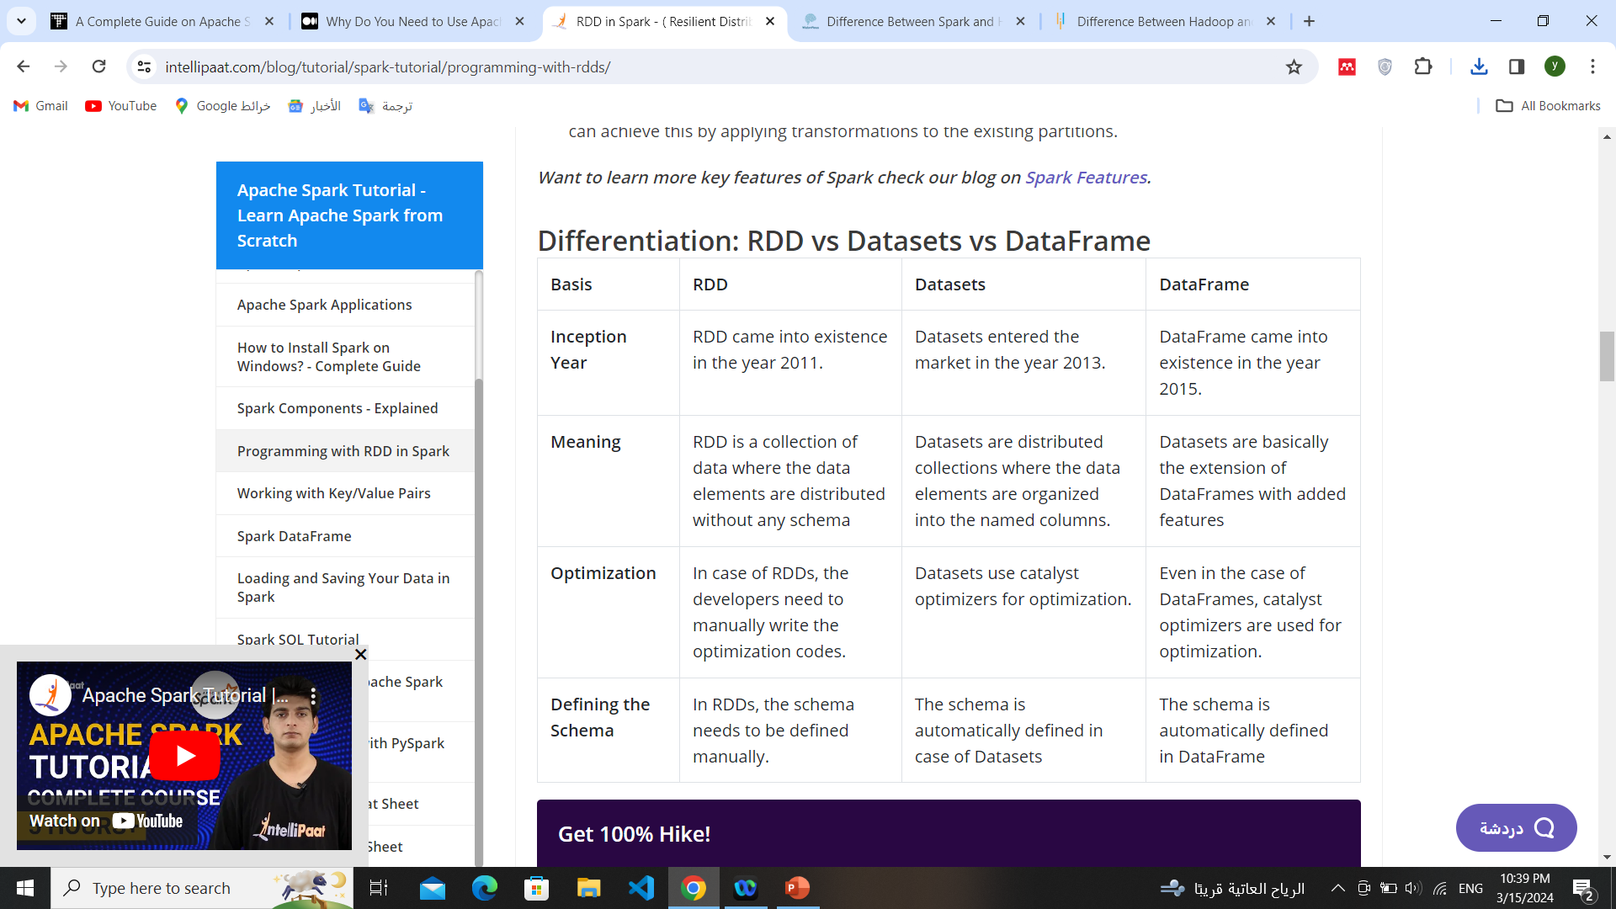

Slide 17
Resources
Books
Learning Spark (O'Reilly)
Documentations
Hadoop vs spark
spark tutorial
Medium Article: Why Do You Need to Use Apache Spark for Your Big Data Project?
Turing Knowledge Base: What is Apache Spark?
Apache Spark Tutorial: Features Overview
YouTube Courses
Spark in Arabic
Apache Spark & Scala Tutorial Videos
PySpark Tutorial
Code
Check code on GitHub

